Slide 1
design and implementation of a “njangi” application system
Members:
Chunke Blessing
TABE JOEL
Ousmanou Bouba
Ashu Brandon
Samme Samuel
Fuga Manguuue Francisco
Course instructor: Eng. KAH KISSINGER

Slide 2
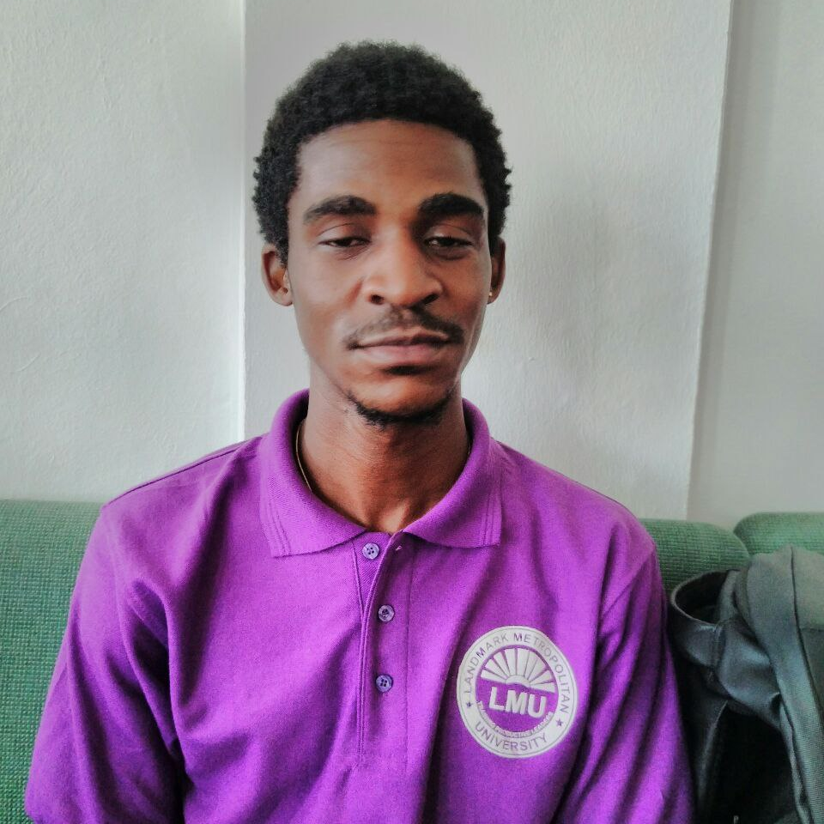
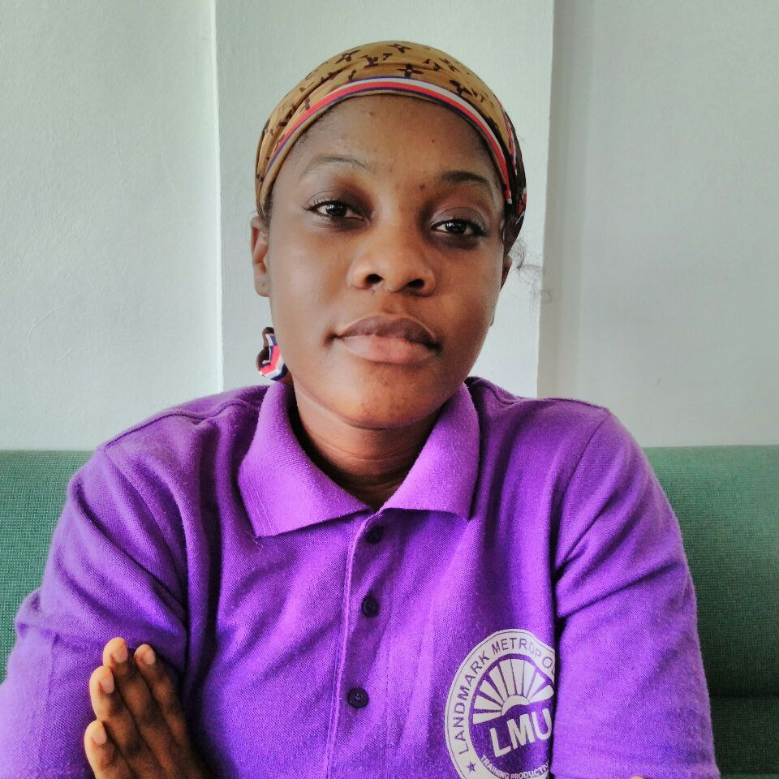
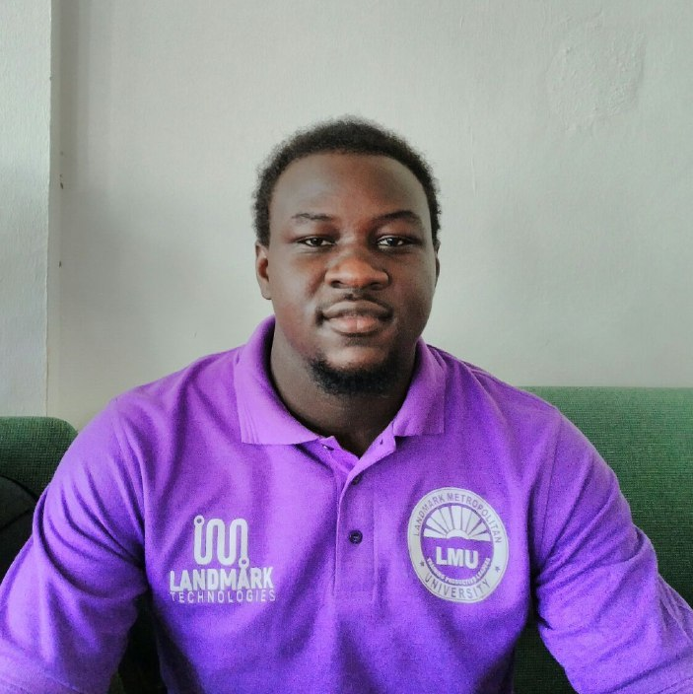
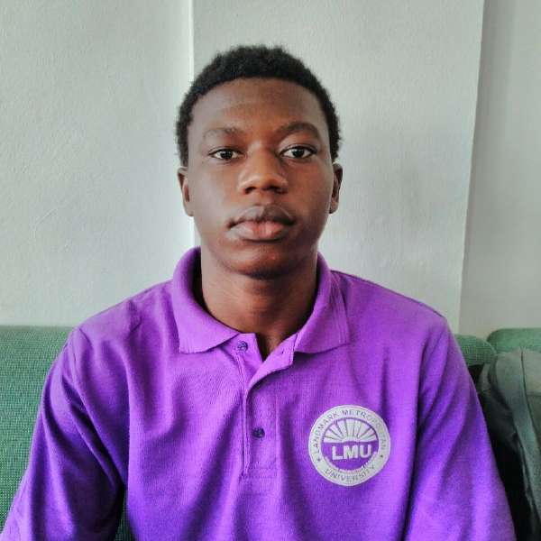
team
CHUNKE BLESSING
OUSMANOU BOUBA
FUGA MANGUE
SAMME SAMUEL
Role in the project:
Analysis Lead
Power point representation
UML diagrams
Role in project:
Figma representation
Role in project:
Documentation
Project Lifecycle
Role in project:
Research

Slide 3
CONTENTS
Introduction
Objectives
Requirements
Project lifecycle
UML diagrams
Use case diagram
Sequence diagrams
Class diagrams
Activity diagram
Business Opportunities
Figma representation

Slide 4

INTRODUCTION
“NJANGI” is a contribution given to members in a rotating form at every sitting .In Addition, a “NJANGI” system helps members to carry out financial activities in a cultural and lovely manner with a good relationship with each members without having to pay for the services offered like what banks charges to it’s members .

Slide 5
objectives
SECURELY SAVE MONEY
Security is a critical objective of a “NJANGI” application. It ensures security measures to protect members information, financial data, and so on.
User-Friendly Interface
The application aims to provide a user-friendly and intuitive interface that is easy to navigate and understand

Slide 6
OBJECTIVES
The application sends automated reminders to participants to make their contributions on time, reducing the likelihood of missed payments.
PAYMENT REMINDERS
MUTUAL AID AND SUPPORT
The App will aim to provide financial assistance to it’s members in times of need and it can offer low interest loans amongst the members

Slide 7


FUNCTIONAL REQUIREMENTS
COMMUNICATION AND NOTIFICATION
REPORT AND ANALYTICS
The application should generate financial reports to provide insights of the “NJANGI” projects progress monthly.
The beneficiary member is sent a documentation of the run down of the contribution. The process is automated
The application should enable seamless communication amongst group members, it should not allow users to send messages, announcement, or alerts to the entire group or specific individuals unless under admin approval.

Slide 8

NJANGI GROUP CREATION
The admin initiates a new njangi group providing group details such as a group name , contribution amounts and rules.
Admin :
Create
Delete
Assign group roles

Slide 9
USER REGISTRATION AND AUTHENTICATION
-Admin creates user accounts and provides them with login credentials(password and username) for them to easily have access to the application
-Users have the privilege to reset their passwords.

Slide 10


Non-FUNCTIONAL REQUIREMENTS
PERFORMANCE
The application should be able to handle a significant number of significant users and transactions , the application will be set to place a fine to members who borrow from the njangi with a maximum loan of 100,000frs and do not repay on time and also to contributions that are not made on time , also the app will manage the contributions made in case any incidence happens to the members closest family member such as in case of deaths ,marriages , births.

Slide 11
Non-FUNCTIONAL REQUIREMENTS
SECURITY MEASURES
The application should have robust security measures in place to protect user data ,transactions, and sensitive information this may include authentication , intrusion detection and intrusion prevention systems , encryption and authorization mechanisms

Slide 12
Non-FUNCTIONAL REQUIREMENTS
RELIABILITY
The application should be reliable and available to use at all times ,it should have a minimal downtime and should backups and should be able to recover quickly from any failures or errors
SCALABILITY
The application should be able to accommodate growth and handle an increasing number of users and njangi groups without significant performance, Also the app should be able accommodate members with multiple heads ( contributing units) at most 3 at a time..
DATA PRIVACY
The application should comply with relevant data protection regulations and ensure the privacy and confidentiality of user data . it should also have appropriate data access controls and follow best practices for data storage and handling.

Slide 13
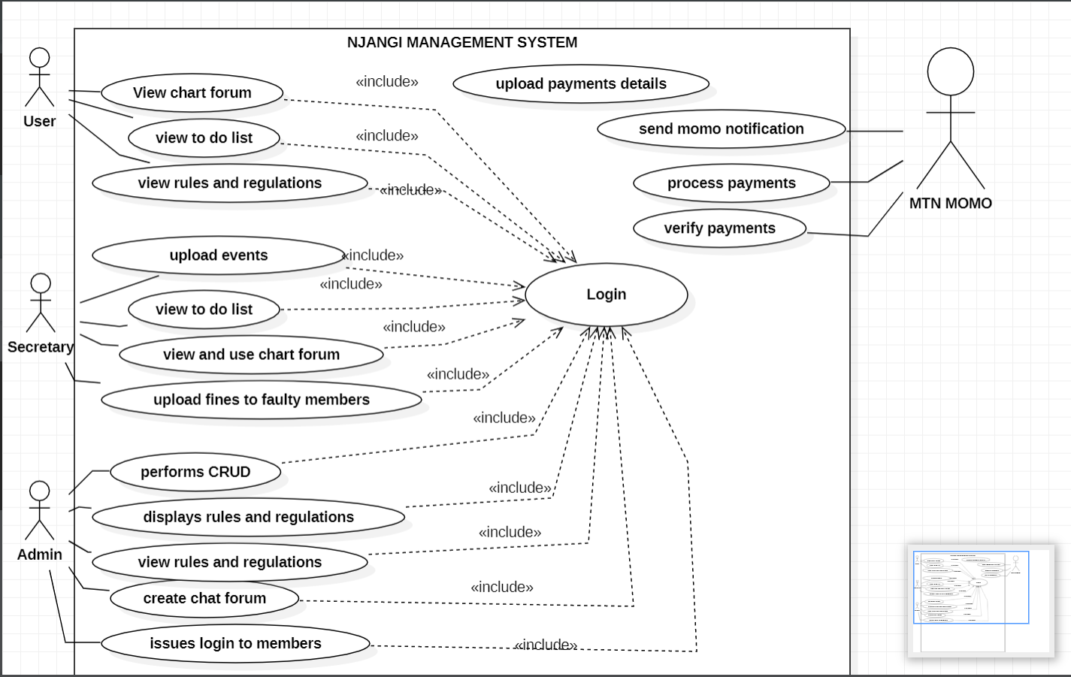
USE CASE DIAGRAM REPRESENATION

Slide 14
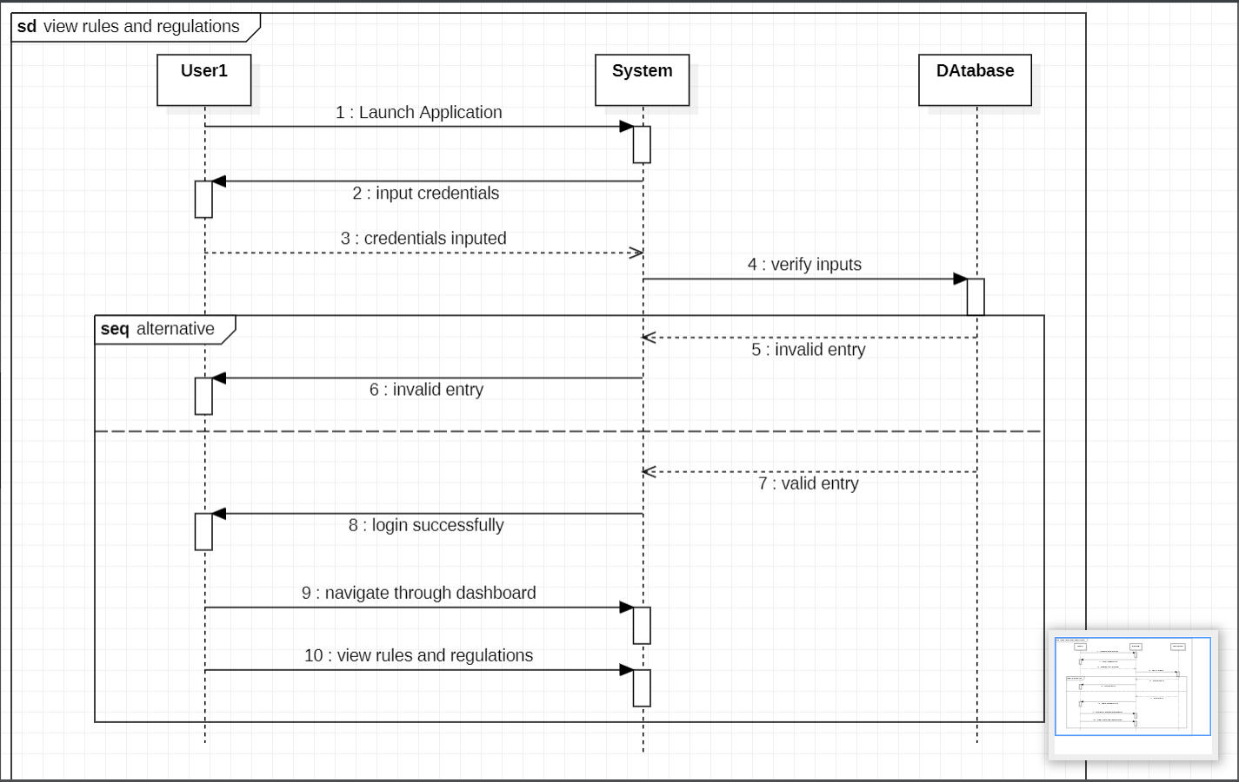
SEQUENCE DIAGRAM showing THE RULES AND REGULATIONS

Slide 15
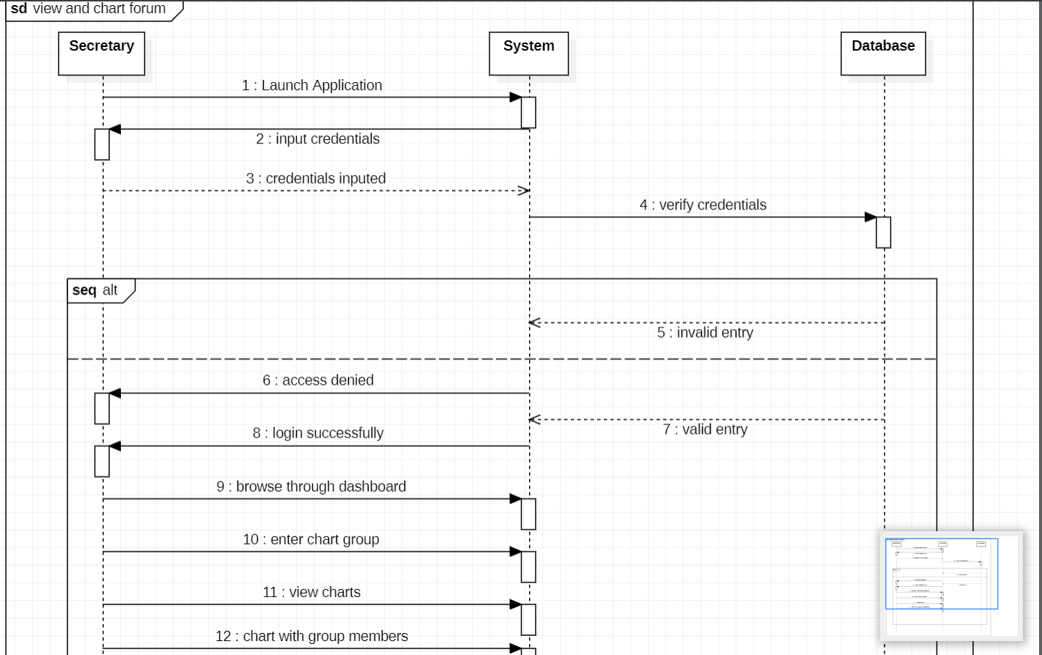
SEQUENCE DIAGRAM for SECRETARY CHARTING WITH GROUP MEEMBERS

Slide 16
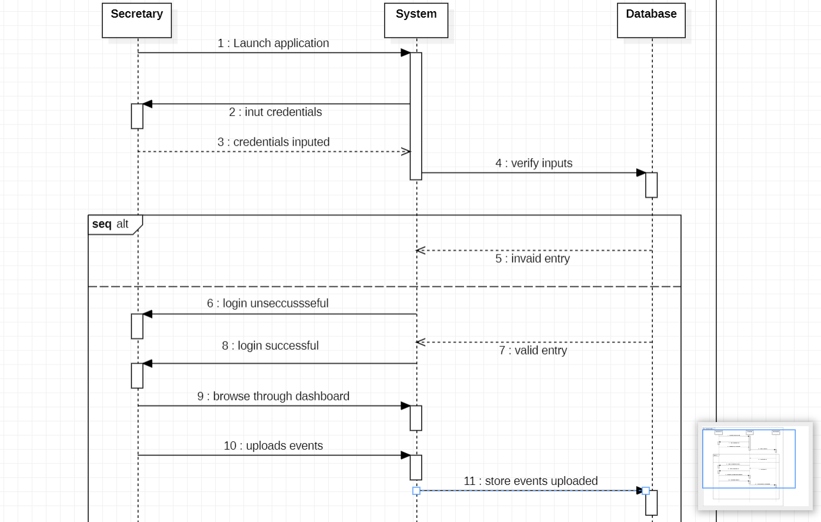
SEQUENCE DIAGRAM showing SECRETARY UPLOADING EVENTS

Slide 17
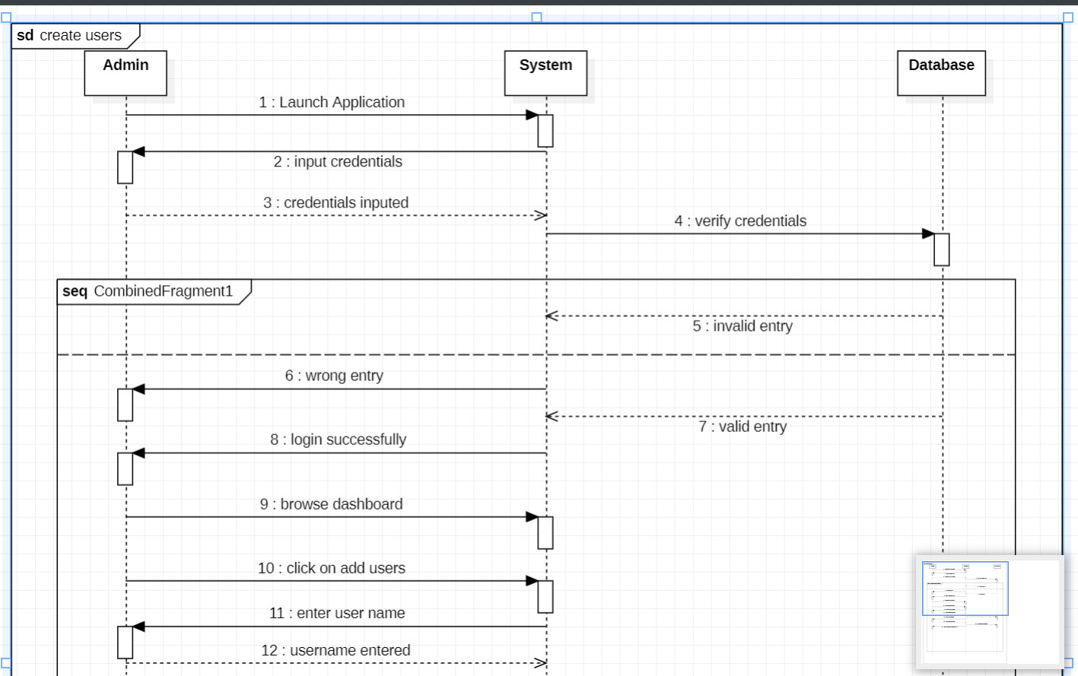
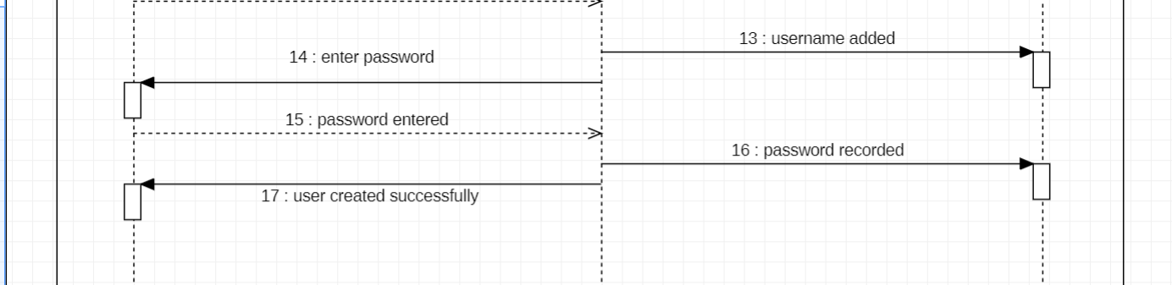

Slide 18
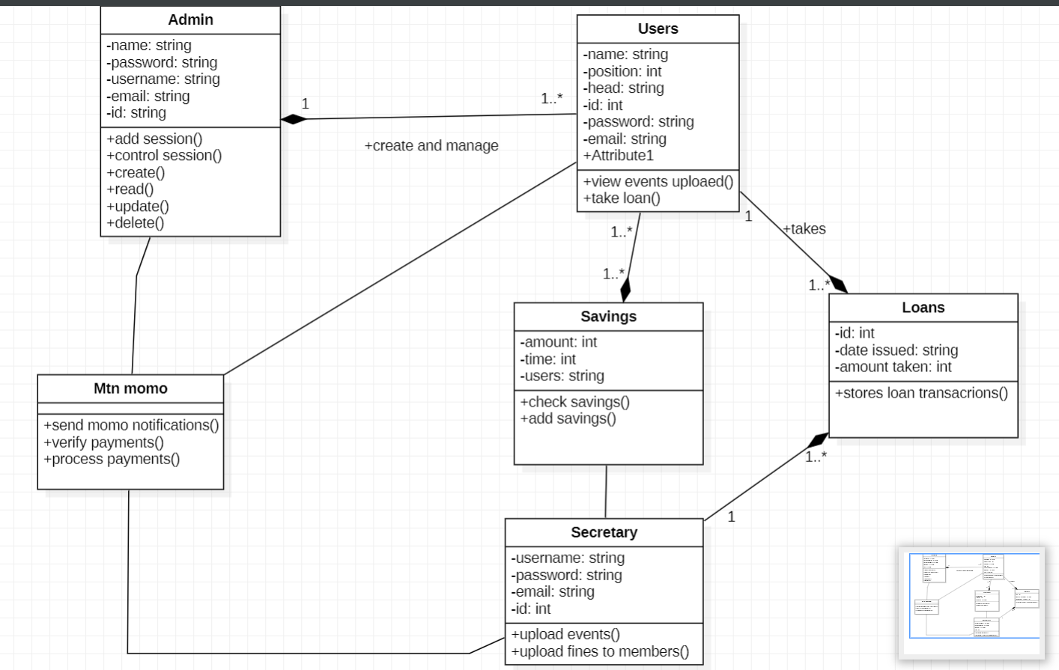
CLASS DIAGRAM REPRSENTATION FOR A NJANGI MANAGEMENT APPLICATION

Slide 19
BUSINESS OPPORTUNITIES
COMMUNITY BUILDING AND NETWORKING
You can establish an online community or forum where njangi participants can exchange ideas and share success stories and seek advice , monetization can be achieved through advertising, sponsored content or premium membership options
CONSULTING AND TRAINING
Providing consulting services on njangi management best practices, legal compliance, and financial literacy can be a viable business opportunities

Slide 20
SECURITY AND DATA PROTECTION
A business focusing on providing robust security measures, encryption and data protection services can find significant demand in this field .

Slide 21
Chart

Slide 22
Table
TOPIC 01 | TOPIC 02 | TOPIC 03 | TOPIC 04 | TOPIC 05
Item 01 | Text | Text | Text | Text
Item 02 | Text | Text | Text | Text
Item 03 | Text | Text | Text | Text
Item 04 | Text | Text | Text | Text
Item 05 | Text | Text | Text | Text
Item 06 | Text | Text | Text | Text
Item 07 | Text | Text | Text | Text
Item 08 | Text | Text | Text | Text
TOTAL | Text | Text | Text | Text

Slide 23

Thank you

